Slide 1

Stroke Prediction Model
Sarah Restrepo
Ironhack Final Project

Slide 2
Objective
Analyze Stroke prediction data set and create a machine learning model to accurately predict if a person will have stroke based on risk factors.
Apply information learned into real world events to accurately identify strokes.

Slide 3
Stroke Statistics
#1Leading cause of long-term disability
#2 cause of death globally
Economic Impact
$56.5B
2018 - 2019
40
seconds Stroke
3:14 seconds death
Notes:
This total includes the cost of health care services, medicines to treat stroke, and missed days of work.
Stroke reduces mobility in more than half of stroke survivors age 65 and older.

Slide 4
Data Variables
Age
Gender
Ever Married
Work type
Residence Type
Smoking Status
Hypertension
Heart Disease
BMI
Average Glucose Level

Slide 5
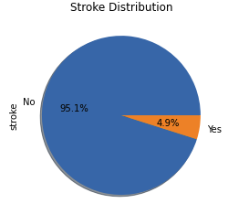
Target Variable
I used SMOTE to balance the dataset, creating synthetic samples for the minority class. This improved model fairness and accuracy by reducing bias towards the majority class.

Slide 6






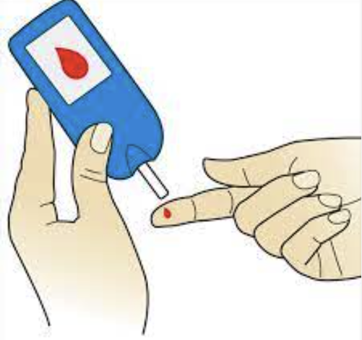
Stroke Proportions
Men
Married
Heart Disease and HTN
Self Employed/ Private
Former/ Current smoker
Older Age
High Glucose Level

Slide 7
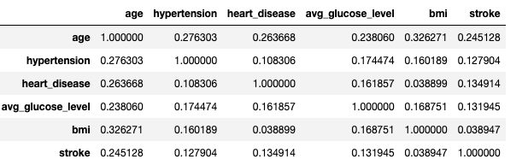
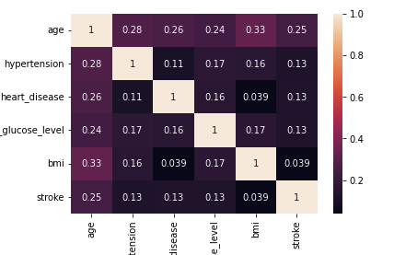
Stroke Correlation

Slide 8
Importance of identifying stroke risks
“TIME IS BRAIN”
- National Stroke Protocol
- 10 minutes
Age, glucose level, BMI, Gender, Hypertension
- 25 minutes
Work type, Residence, Married, Smoking Status, Heart disease
- 45 minutes
Based on all the information collected, MD will decide if patient is a candidate for a life saving/disability saving drug.
-60 minutes
Give life saving drug

Slide 9
Models
Logistic Regression Accuracy =79% Precision =76% Sensitivity =85% Specificity =73% ROC/AUC = 85% | KNN – 5 Accuracy =91% Precision =85% Sensitivity =99% Specificity =82% ROC/AUC = 97% | KNN – 10 Accuracy =89% Precision =82% Sensitivity =99% Specificity =79% ROC/AUC = 96% | Random Forest Accuracy =97% Precision =96% Sensitivity =98% Specificity =95% ROC/AUC = 99% | XGBoost Accuracy =96% Precision =95% Sensitivity =97% Specificity =95% ROC/AUC = 99% | XGBoost with Hyperparameters Accuracy = 83% Precision = 78% Sensitivity = 91% Specificity = 74% ROC/AUC = 99%

Slide 10
Preferred Model
Random Forrest 97% Accuracy 98% Sensitivity 95% Specificity 99% ROC/AUC Considerations: - Overfitted model -Cross validation - consistent performance | XGBoost 96% Accuracy 97% Sensitivity 95% Specificity 99% ROC/AUC Considerations: -Overfitted model -Keep tuning parameters for a better fitted model -Feature importance

Slide 11
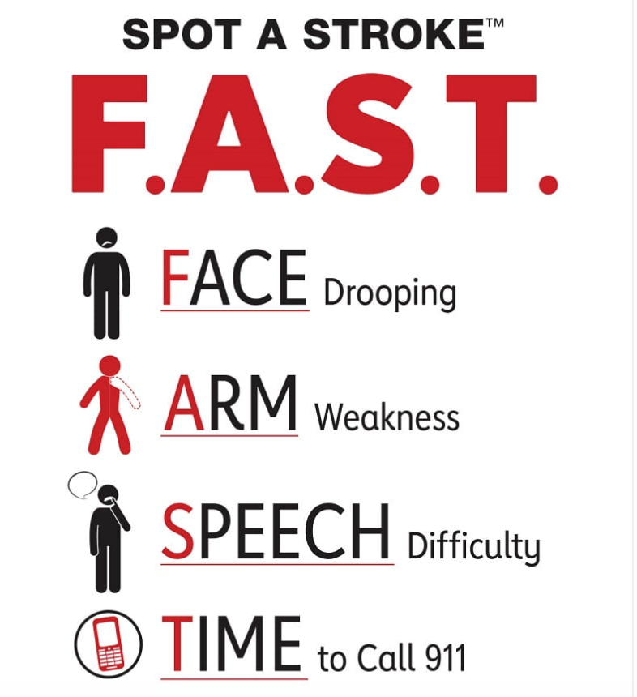
“Time is Brain”

Slide 12

Thank you!!!

